Slide 1
Comparative study for pattern analysis and recognition of musical segments
Guide- Ms A.M. Kulkarni
Domain- Speech processing
GROUP NO. 85
PANKAJ SINGH B120053156
MANALI MOHITE B120053138
JATIN HEDAOO B120053080
Electronics and Telecommunication

Slide 2
ABSTRACT
In this project, we are dealing with the analysis and recognition of musical segments inside any musical audio file given to the software.
We would have a basic database of all the segments or patterns that are generally observed.
We would then give in any audio input signal to the software, now the system will detect the musical notes present in the input signal.
Then we apply the fast fourier transform algorithm to each detected segment or note in order to find the fundamental frequency.
Now once we get the fundamental frequency then it used to convert to particular note name corresponding to that frequency.
This will result in getting the order in which the notes are present in the audio file.
I

Slide 3
Relevance
Musical analysis is used effectively for understanding of how tonal (and other forms of music) are constructed.
Understanding how this process works can help with the phrasing and expression of the music.
Understanding the structure of music from different periods is an important skill for composers.
This project aims at easing the idea of music analysis and processing so as to widen the scope for in depth study of the same.

Slide 4
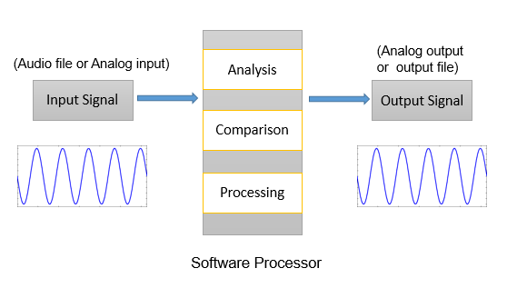
Block Diagram

Slide 5
Extracting note names from the segments using the note table.
Dividing audio file into segments
Read Input Audio file
Read Input Audio file
Finding fundamental frequency
Frequency to note name conversion
COMPARISON PHASE
Compared and analysed output file

Slide 6
Specifications:
Input file: wav file
T=20sec
L= 512 points //Window size
fs= 44100 Hz //Sampling frequency
N= 1024 //no. of DFT points

Slide 7
SYSTEM DESIGN AND REQUIREMENTS
Hardware and Software Requirements
Software:
Matlab, input files (.wav )
Functional Requirements
The system should process the input given by the user only if it is an audio file (.wav file etc.)
System shall compare the given input audio files when the input given is in the required format.
System should detect same pattern present in the audio files.

Slide 8
Software Processor (MATLAB):
The project is built in MATLAB R2013a Windows version.
The UI is developed using MATLAB Graphical User Interface (GUI).
The UI also provides advanced features like plots of power spectrum , STFT, Chromagram , note name according to standard sheet music notation, etc.

Slide 9
Audio input files
Audio signals have frequencies in the audio frequency range of roughly 20 to 20,000 Hz .
Digital representations of audio signals exist in a variety of formats. In our project we are using audio files in .wav format for analysis.
This format is based on the Resource Interchange File Format (RIFF), this stores chunks and sub-chunks which are each indexed. The usual bit stream encoding is the linear pulse-code modulation (LPCM) format.
WAV stands for waveform audio file format.

Slide 10
Sample Audio signal
Power Spectrum

Slide 11
Analyzing Process:
Step by step execution of an audio signal, used to convey the inputs, outputs, and operations that take place during each phase.
A process analysis can be used to improve understanding of how the process operates, and to determine potential targets for process improvement through removing waste and increasing efficiency.
In our project, we have used the note analysis method to get the result.
So, the analysis is note base, i.e., basically it is frequency based analysis.
Following is the algorithm that we have used for it:

Slide 12
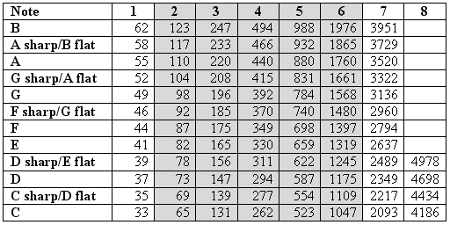
Note based analysis:
In this analysis, we have broken down the audio file into fragments and then found out the frequency of them and compared the frequency to the frequncy of the notes in the note frequency chart which is shown below.

Slide 13
Then with respect to the frequency matched, we assigned the particular fragment the note associated with it.
By doing this we have, in turn gotten the order of the note appreances in the input music audio file.
Doing this, made it easy for us to compare the input file to the already present data base.
We also found out that every note has its own specific chromogram, as can be seen from the picture attached:

Slide 14
Note detection algorithm:
Input audio file is taken as read and converted into an array with one stream.
The array stores the audio signal with sampling frequency 44100 samples per second.
Once a note region is isolated we apply Fast Fourier Transform to the region and analyse the data by plotting the power spectrum of the signal.
Then the frequency is estimated using two different fast algorithms and the appropriate frequency is taken.
The frequency thus obtained is used to calculate the note name of according to the standard sheet music notation.

Slide 15
SEGMENT DETECTION
FAST FOURIER TRANSFORM
AUDIO INPUT
FREQUENCY TO NOTE CONVERSION
OUTPUT INTERFACE AND GRPAHS
FUNDAMENTAL FREQUENCY DETECTION

Slide 16
Note name from Frequency
Note frequency chart

Slide 17
Short-time Fourier transform (STFT):
The short-time Fourier transform (STFT), or alternatively short-term Fourier transform, is a Fourier-related transform used to determine the sinusoidal frequency and phase content of local sections of a signal as it changes over time.
In practice, the procedure for computing STFTs is to divide a longer time signal into shorter segments of equal length and then compute the Fourier transform separately on each shorter segment.
This reveals the Fourier spectrum on each shorter segment. One then usually plots the changing spectra as a function of time.

Slide 18
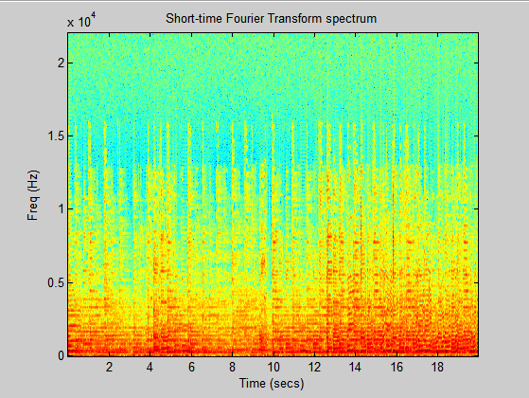
SPECTROGRAM

Slide 19
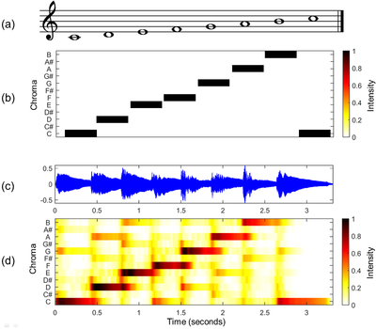
Figure 1 :(a) Musical score of a C-major scale.
(b) Chromagram obtained from the score.
(c) Audio recording of the C-major scale played on a piano.
(d) Chromagram obtained from the audio recording.

Slide 20
Comparison:
In order to get similarity between any two given audio input files, we used dynamic programming to compare the detected notes from the audio file.
The comparison result shows the longest similar segment in the given audio files.
Two different algorithms can be used for this purpose:
1- Suffix tree algorithm
2-Longest common substring using dynamic programming

Slide 21
Comparison algorithm:
Dynamic Programming:
We used dynamic programming to solve this problem in bottom-up manner. We Cre­ated a matrix of size of m*n and stored the solu­tions of sub­strings to use them later.
Base Cases: If any of the string is null then LCS will be 0. Check if i^{th} character in one string A is equal to j^{th} character in string B
Case 1: both characters are same LCS[i][j] = 1 + LCS[i-1][j-1] (add 1 to the result and remove the last character from both the strings and check the result for the smaller string.)
Case 2: both characters are not same. LCS[i][j] = 0
At the end, traverse the matrix and find the maximum element in it, this will the length of Longest Common Substring.

Slide 22
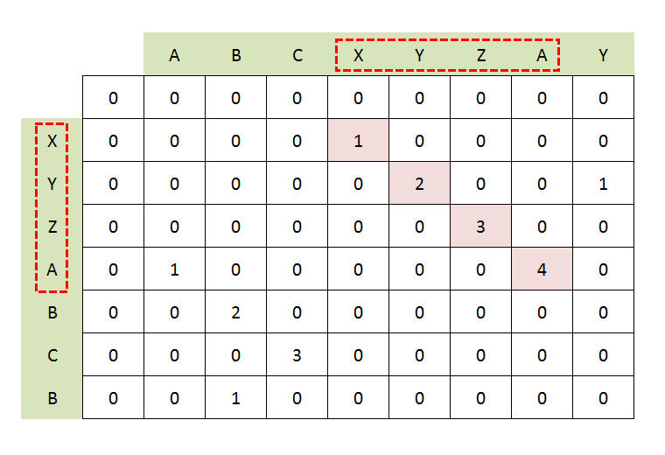
Detected Notes of Audio input 1
C# D D# E F
C#
D
D#
E
Detected Notes Audio input 2

Slide 23
RESULTS
When we increased the tempo of the audio signal then the accuracy of our system reduced.
Using Note Detection algorithm, we found the notes present in the given audio input signal.
We also compared different audio signals in order to find similarity between them using dynamic programming.

Slide 24
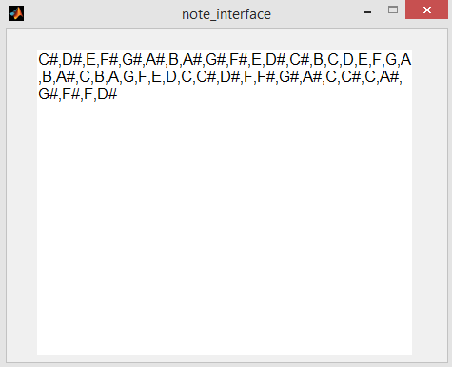
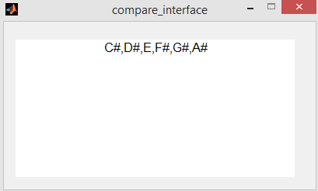
Detected Notes of “sa.wav” file given to the system.
Comparison result of two audio files “sa.wav” and “sa-cdefg.wav” given to the system.

Slide 25
CONCLUSION
In our project, we designed and implemented an effective and user-friendly frequency estimation system with Fourier Analysis.
The target users of the system are not only the people practicing music, but also professional musicians who cannot waste their time figuring out the notes of an audio sample.

Slide 26
FUTURE PLAN
Multiple Notes at a time:
Non Periodic Signal analysis:
Advanced Note Detection:

Slide 27
References
Robert Schalkoff ,“Pattern Recognition”, Wiley.
L. R. Rabiner and S.W. Schafer, “Digital processing of speech signals” Pearson Education.
C. M. Bishop, Christopher, “Pattern Recognition and Machine Learning”, Springer.
Shaila D. Apte, “Speech and Audio Processing”, Wiley India
Carnegie Mellon University Research Showcase @ CMU; Computer Science Department.
School of Computer Science; 10-2002 Pattern Discovery Techniques for Music Audio.
P. Rao, Chapter in Speech, Audio, Image and Biomedical Signal Processing using Neural.
Finding repeating patterns in acoustic musical signals applications for audio thumbnailing. Jean-Julien . Mark Sandler

